Slide 1

What ’s Video Game Listings Tell Us About Customer Preferences
Team Number: 5A
Andrew Sager, Anthony Chang, Cynthia Wen, Rutul Bokade & Shyami Govind

Slide 2
Table of contents
01
02
03
04
05
06
Introduction
Project Roadmap
Data Acquisition and Organization
Analysis Methods
Data Analysis and Discussion
Conclusion

Slide 3
01
Introduction

Slide 4
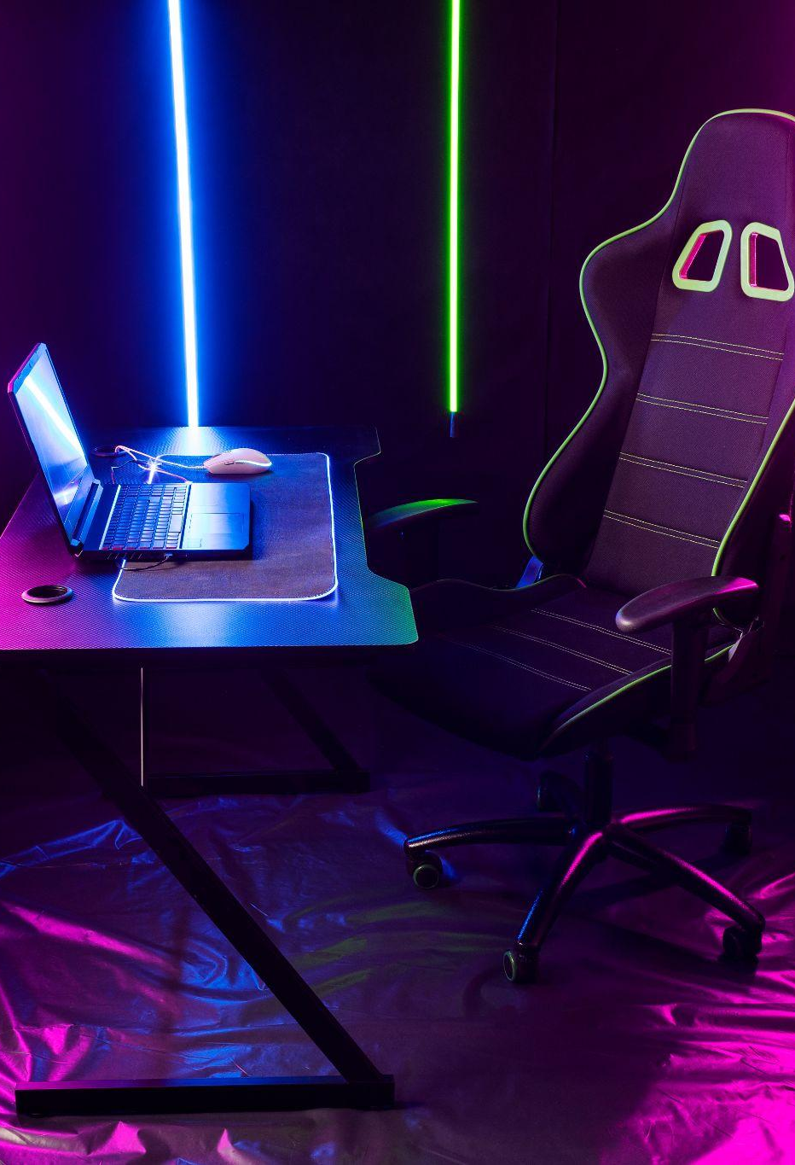
Introduction
Analysis of ’s Video Game Segment
Focus: Gaming equipment (consoles and accessories) on BestBuy.com, leveraging consumer ratings and product attributes to analyze trends and spending patterns.
Key Questions:
Attributes of Consumer Decision-Making: How do purchasing criteria differ for consoles vs. accessories?
Brand Rating Analysis: Which brands offer consistent quality (high ratings) vs. those with high variability?
Review Insights: Key words in positive vs. negative consumer reviews.
Brand Strengths: Which brands dominate specific accessory categories based on ratings, sales, and product variety?
Objective:
Provide actionable insights into consumer behavior and brand performance to enhance understanding of the video game equipment market.

Slide 5
02
Project Roadmap

Slide 6
Project Roadmap
Preliminary Data Research
Outline the project plan
Data Scraping and Acquisition
Data Cleaning and Preprocessing
Exploratory Data Analysis
Data Visualizations
Data Insights and Discussions
Conclusion

Slide 7
03
Data Acquisition and Organization

Slide 8
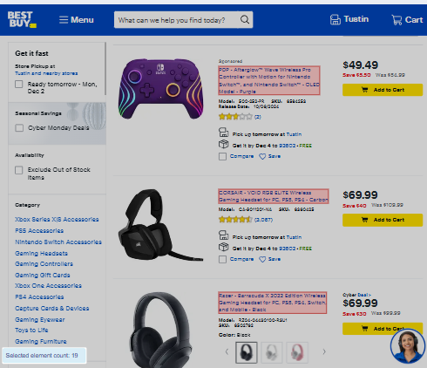
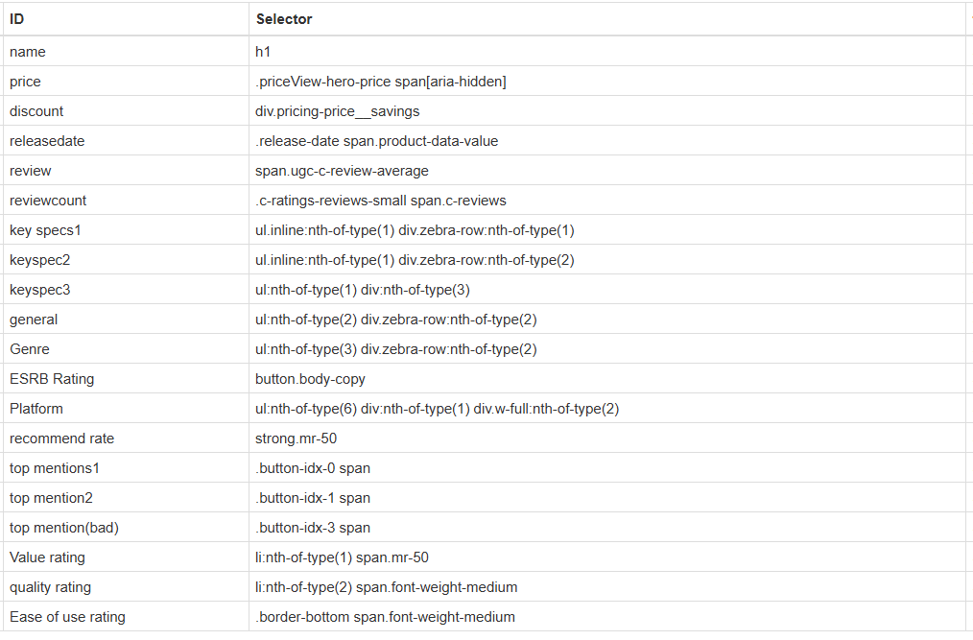
Data Acquisition
Datapoints selected for Scraping
Product Details - Product name, brand, model and release date
Price and Discount Data - Current price, discount amount, and original price.
Specification Details - Product-specific attributes like compatibility (e.g., Xbox, PC, etc.) and wireless capabilities.
Reviews and Ratings – Overall ratings, Specific score for Value, Quality and Ease of use and the top Positive and Negative mentions.

Slide 9
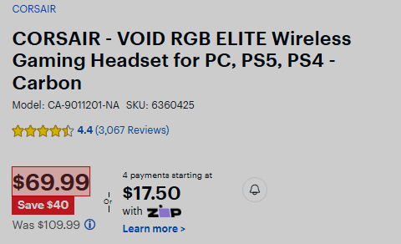
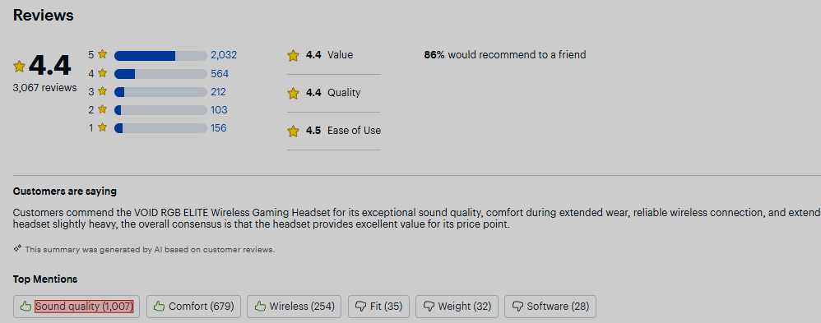
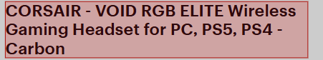

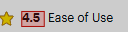
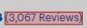
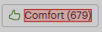
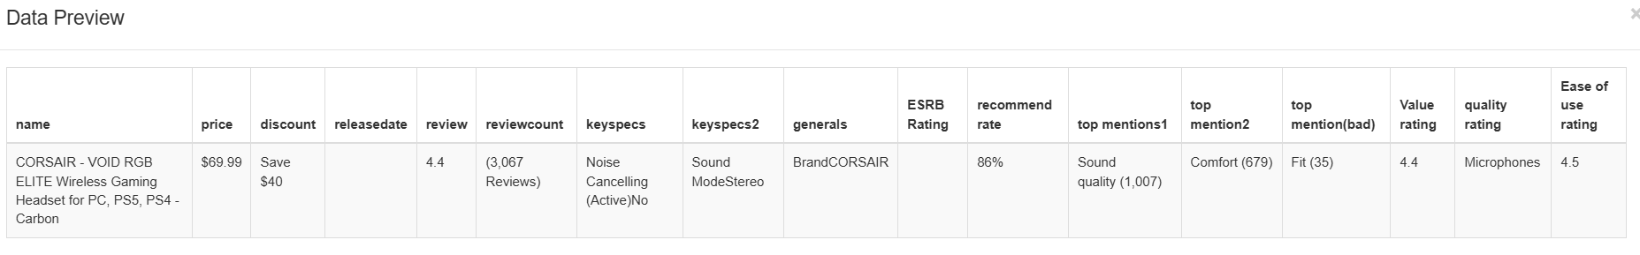
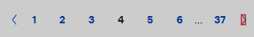
Data Acquisition – Web Scraper App

Slide 10
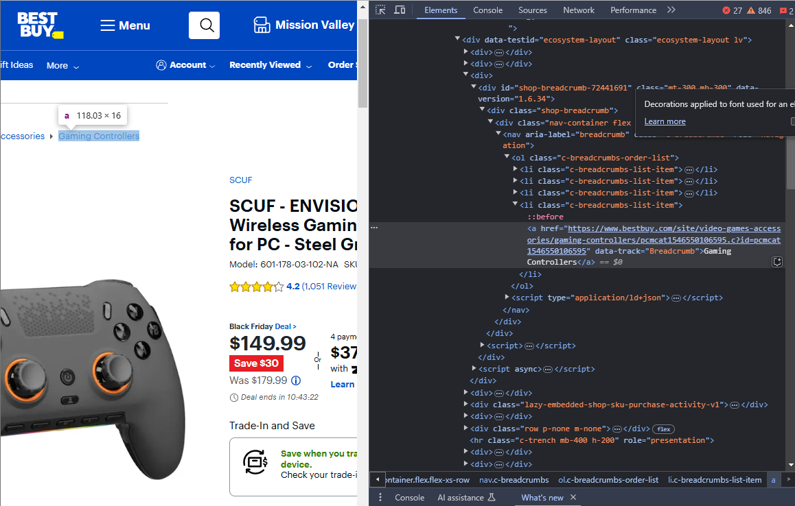
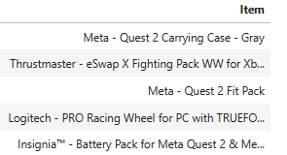
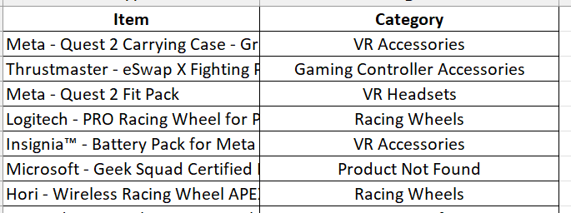
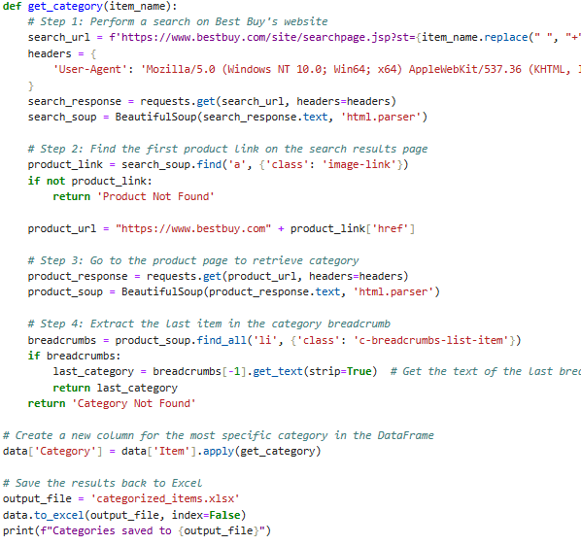
Data Acquisition – Web Scraping Beautiful Soup
Scraped Output – Item Category
Search Product: Query BestBuy’s search URL using the item name
Locate Product Link: Parse the search results page using HTML tags (class: image-link) to extract the product's URL.
Access Product Page: Visit the extracted product URL.
Extract Category: Parse the product page to locate breadcrumbs (class: breadcrumbs-list-item) and retrieve the last item in the list for the item category.
Store Category: Save the retrieved category into a new column into our data frame.
Accessory subcategories were web scraped using the Beautiful Soup web scraping Python Library

Slide 11
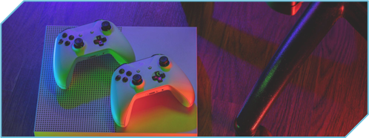
Data Organization
Most impactful issues:
The "Wireless" column did not properly translate to our data file, we had to use Excel functions to separate the values of the column into binary yes/no attributes
"USB ports" number category also did not properly translate into our data, Excel functions were used to manually search for the number of ports each product had
We found it important to include a "Compatible Platforms" attribute as well to ensure specificity in our analysis. This was added in ad hoc and also required Excel formulas to maintain consistency.

Slide 12
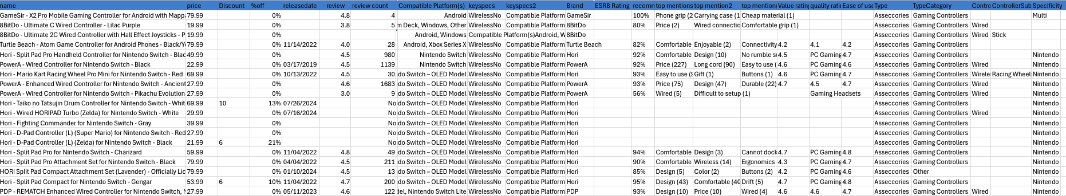
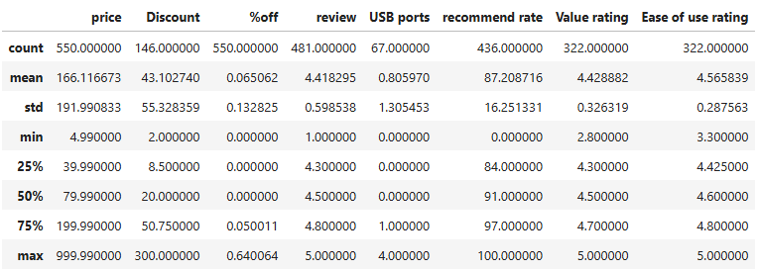
Data Organization
Scraped and Cleaned Data
550 records
30 attributes
Descriptive Statistics

Slide 13
04
Analysis Methods

Slide 14
Key Methods and Tools
Data Preparation
Standardized date formats for trend analysis.
Managed missing data and transformed categories.
Advanced filtering for brand rankings (e.g., ease-of-use).
Statistical Analysis
Descriptive Statistics
Grouping and aggregation
Predictive Modelling
Random Forest model
Data Visualizations
Bar charts
Boxplots
Histograms & KDE plots
Line charts
Stacked bar charts
Heatmaps
Natural Language Processing (NLP): Word clouds

Slide 15
05
Data Analysis and Discussion

Slide 16
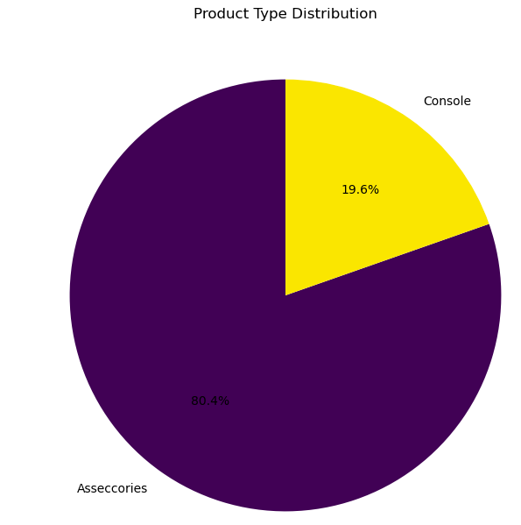
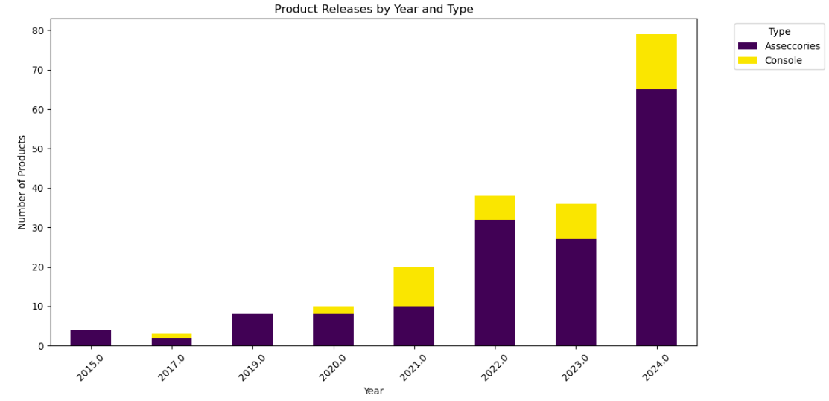
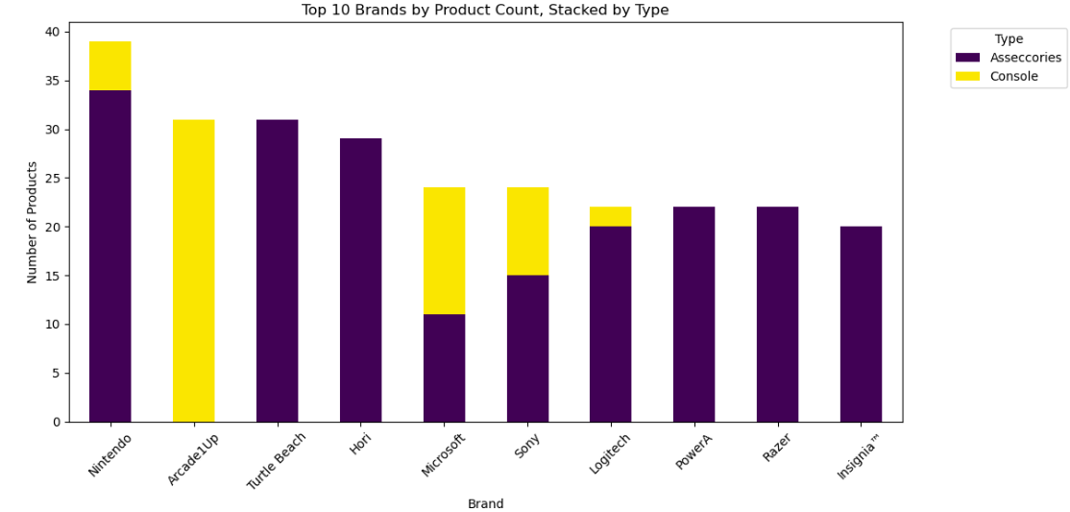
Data Visualizations -
Product Analysis
Product Type Distribution: 80.4% Accessories, highlighting a market focus on supporting hardware over Consoles (19.6%).
Product Releases by Year: Steady growth, peaking in 2024, driven by Accessories.
Top Brands by Product Count: Nintendo leads with a mix of Accessories and Consoles, while others (e.g., Logitech, Razer) focus heavily on Accessories.
Accessories dominate the market, accounting for 80.4% of products, highlighting a focus on supporting hardware.

Slide 17
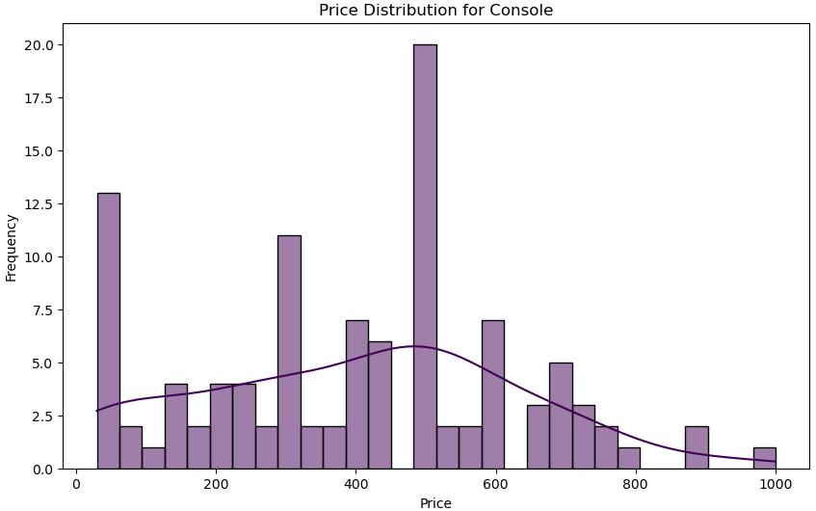
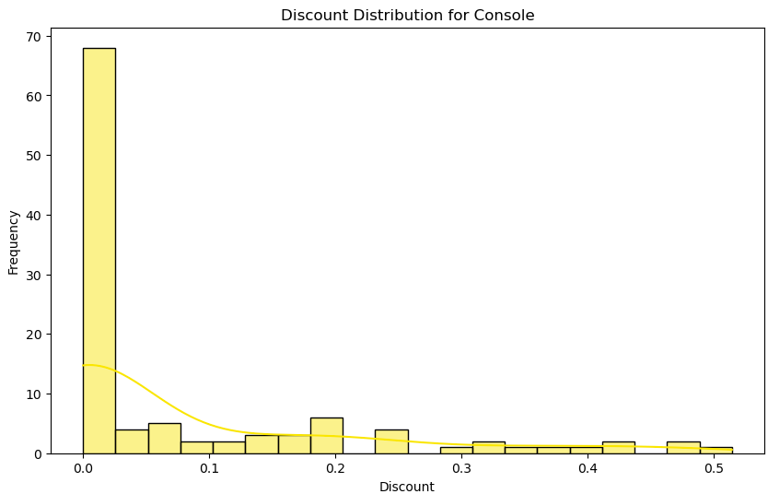
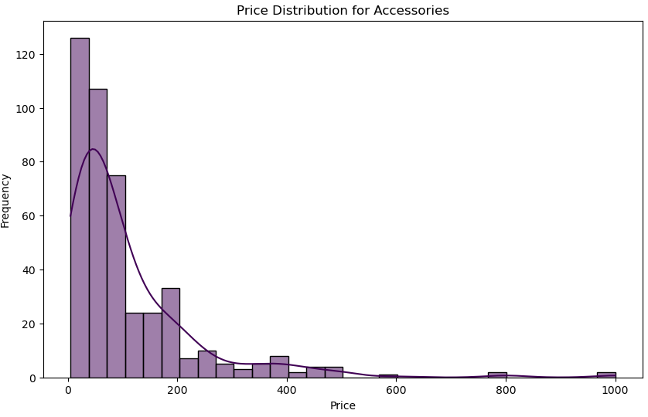
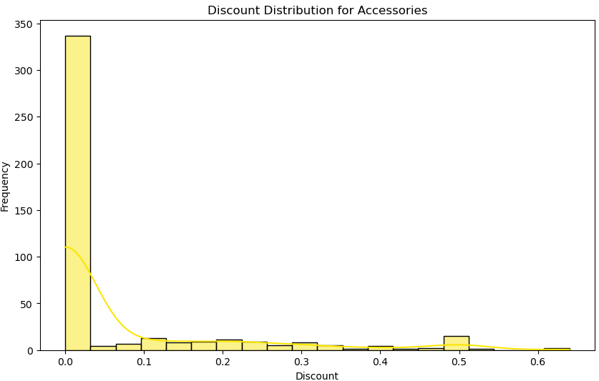
Data Visualizations -
Price and Discount Analysis
Price Distribution:
Consoles: Prices are widely spread, with peaks around $500.
Accessories: Prices are concentrated below $200, reflecting affordability.
Discount Distribution:
Consoles and Accessories: Discounts are minimal, with most products showing little to no markdowns.
Accessories dominate in affordability, while both categories maintain limited discount strategies..

Slide 18
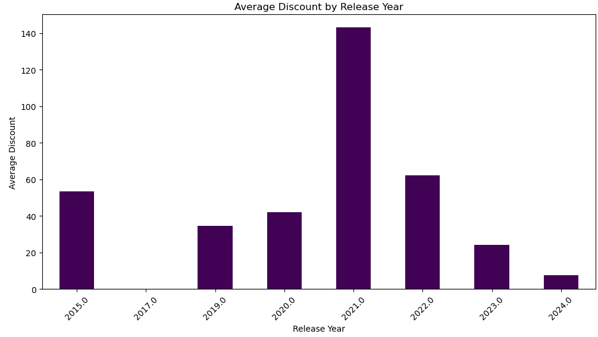
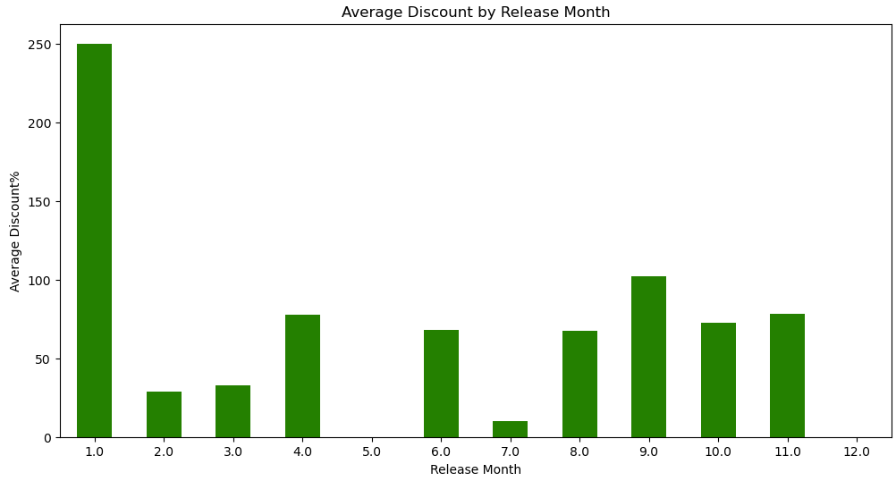
Data Visualizations -
Discount Pattern Analysis
Release Year:
Significant spike in average discounts in 2021.
Consistent but lower discounts observed in other years.
Release Month:
January shows the highest discounts, followed by September and November.
Other months have comparatively moderate or lower discount levels..
Peaked discounts in 2021 could be attributed to COVID sales slumps and the January peaks likely tied to post-holiday sales or inventory clearance.

Slide 19
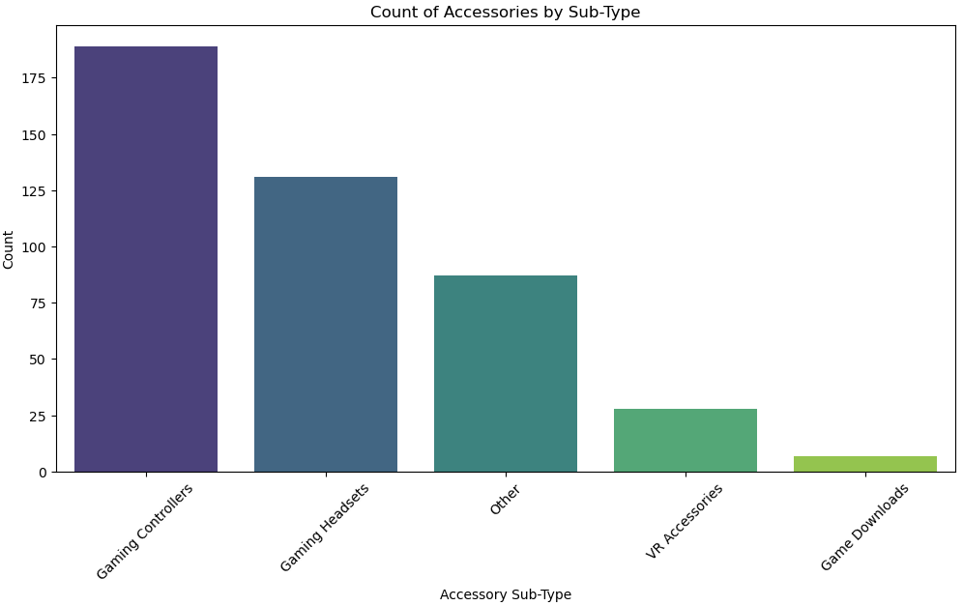
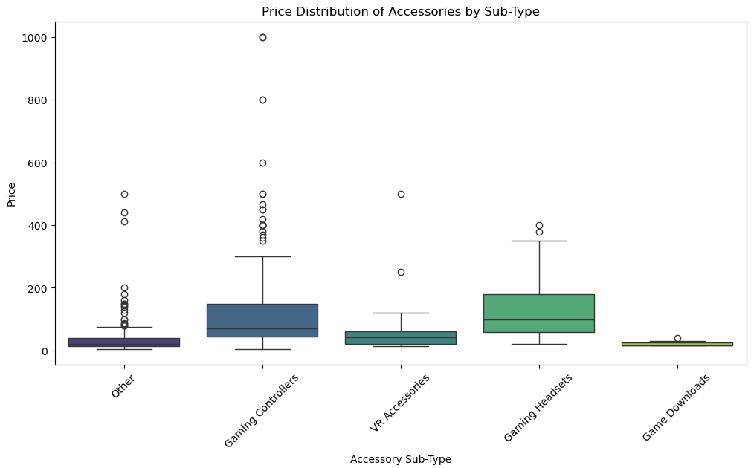
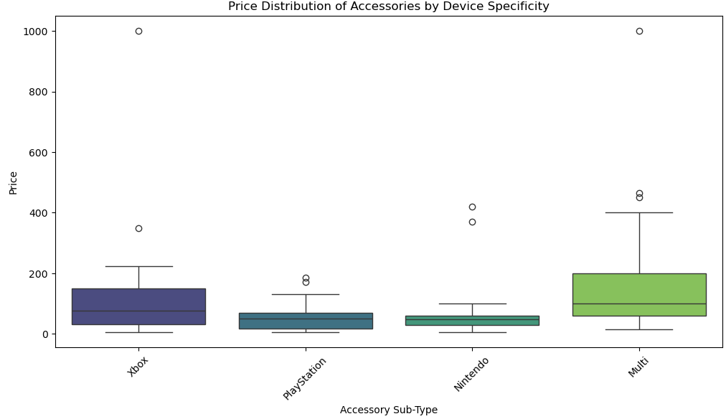
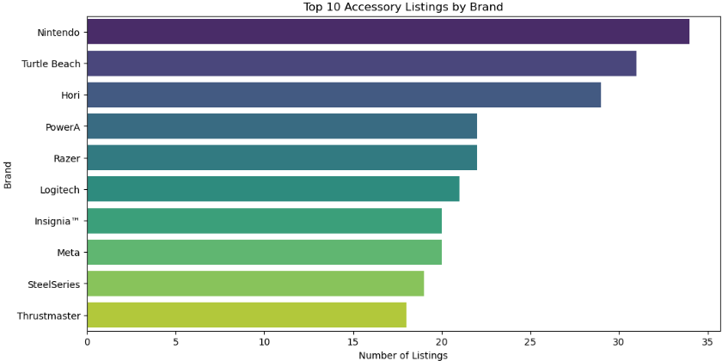
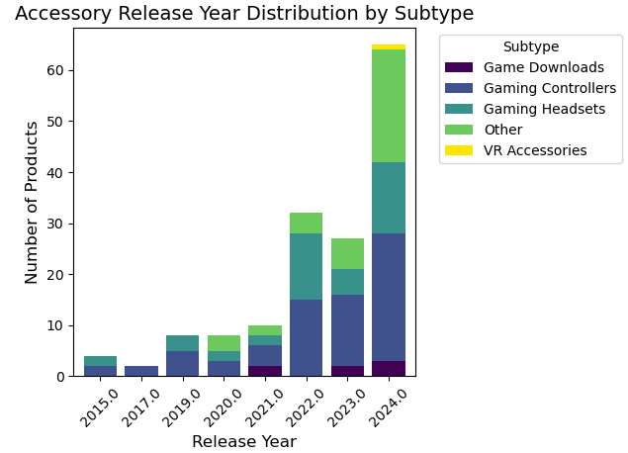
Data Visualizations -
Accessory Analysis
Accessory Distribution by Subtype:
- Gaming Controllers are the most prevalent subtype.
Pricing Insights::
Gaming Headsets and Controllers have the highest price variability, with Controllers being the most expensive.
Multi-platform accessories dominate the higher price range, likely due to their broader usability.
Brand Representation:
Nintendo leads in accessory listings, followed by Turtle Beach. And Hori.
Notable absence of established brands like Microsoft, and Sony.
Release Year Trends:
Steady growth peaking in 2024.
Gaming controllers dominate.
Gaming controllers dominate. Headsets and controllers show the most price variability. Multi-platform accessories drive premium pricing.

Slide 20
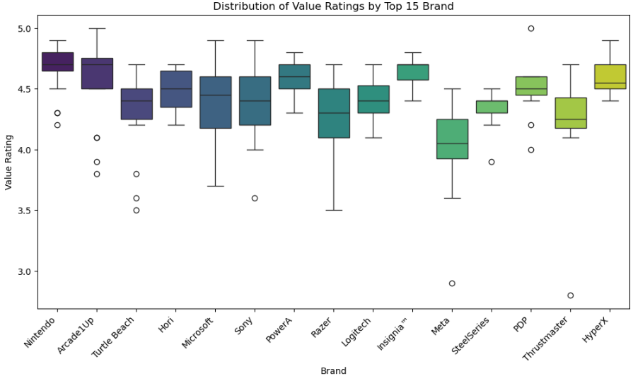
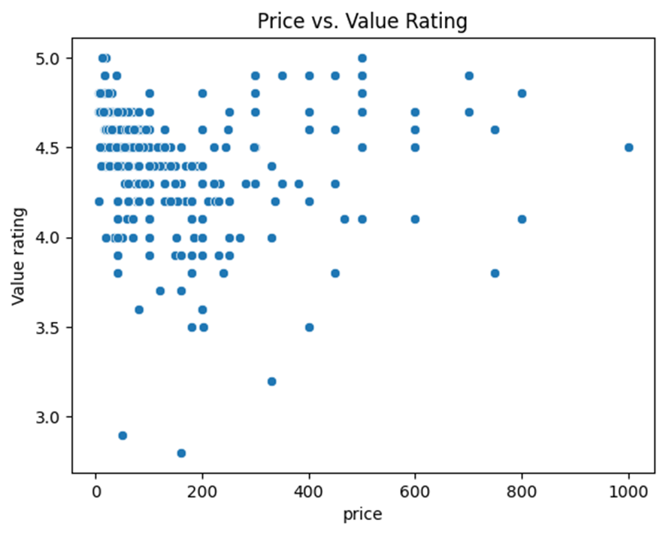
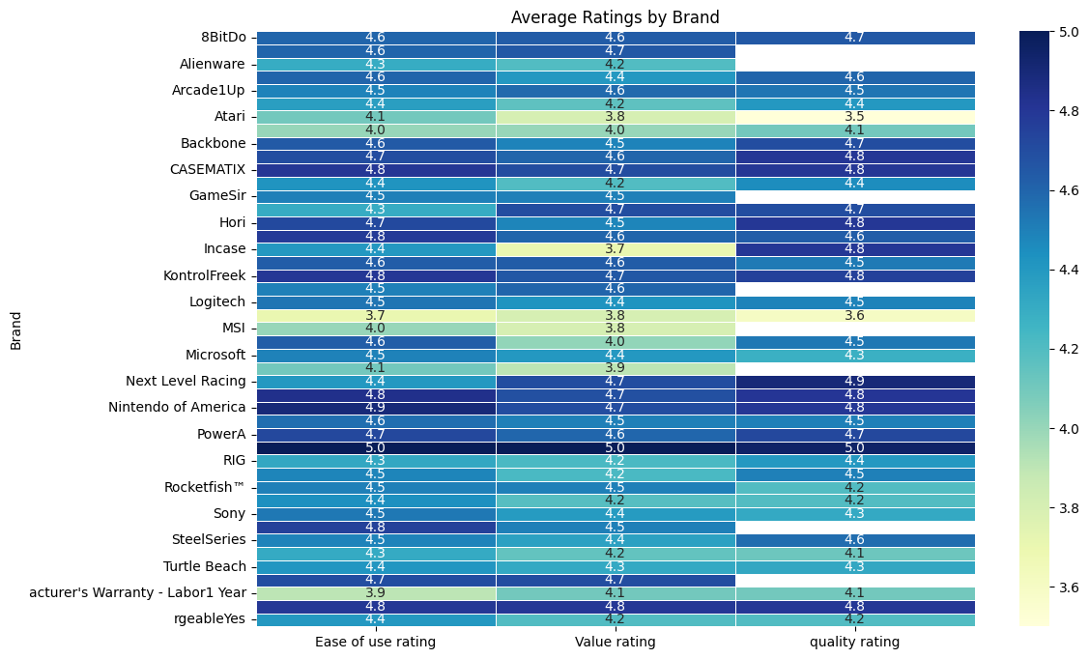
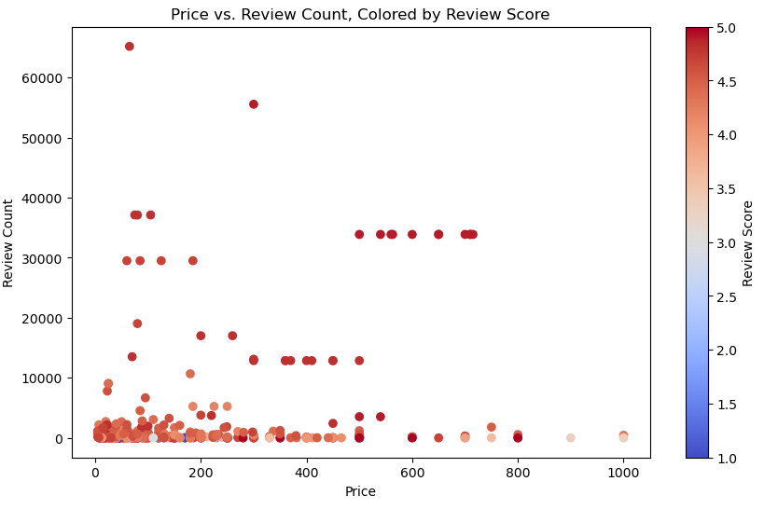
Data Visualizations -
Review Analysis
Value Ratings:
Nintendo and Arcade1Up, successfully deliver on the expectations.
Brand Ratings::
Brands like Nintendo, Arcade1Up, and PowerA consistently maintain high ratings across all three dimensions.
MSI show lower average ratings, indicating room for BestBuy to change their listing proportion of the brand.
Price vs Reviews and Ratings:
Affordable products (<$200) drive higher value ratings.
Premium-priced items (> $400) cater to niche, highly satisfied buyers.

Slide 21
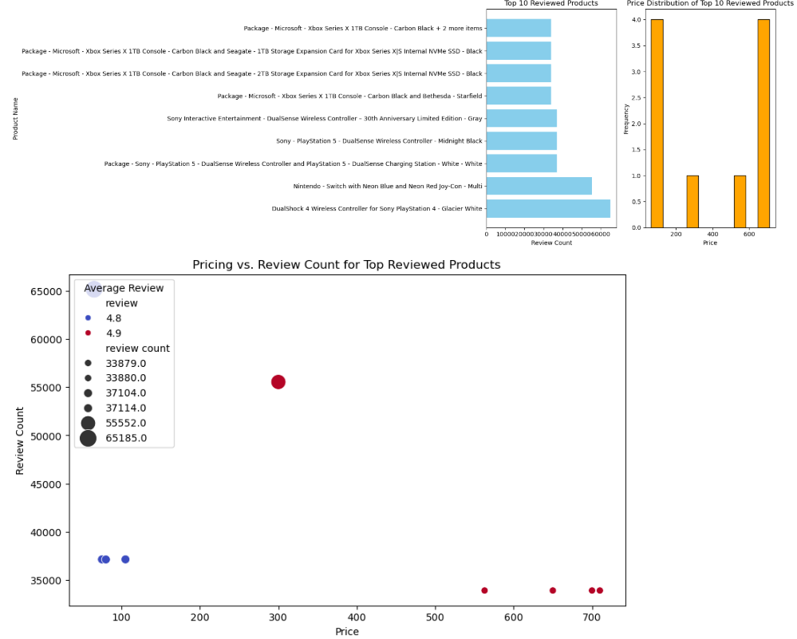
Data Visualizations -
Review Analysis
Top 10 Reviewed Products:
High review counts about 30000 indicate consumer interest
Microsoft and Sony dominate the top reviewed products.
Price Distribution::
2 areas : mid-range and high-end
A balanced mix of affordable and premium products.
Pricing vs. Review Count Relationship:
Products priced below and around $300 have high review counts and high rating.
High – priced products have high rating but lower review counts, suggesting price sensitivity.
Mid-priced products show the strongest correlation between affordability and popularity.

Slide 22
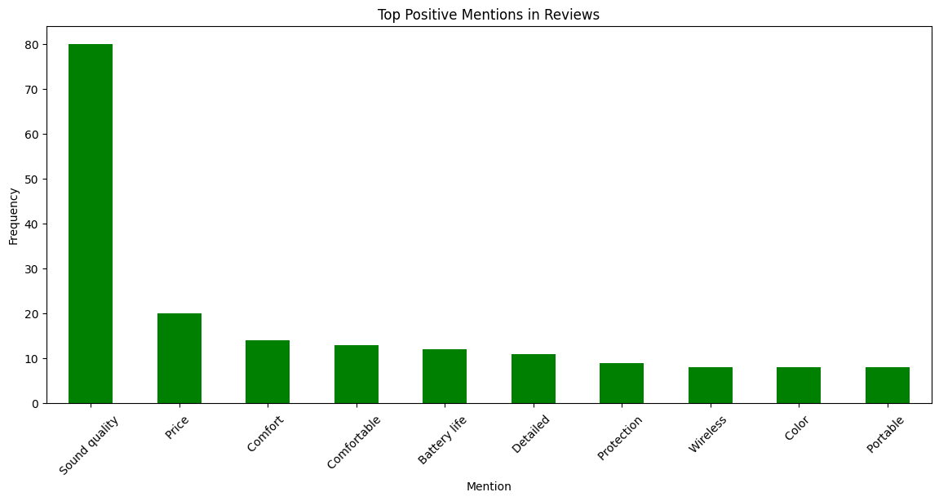
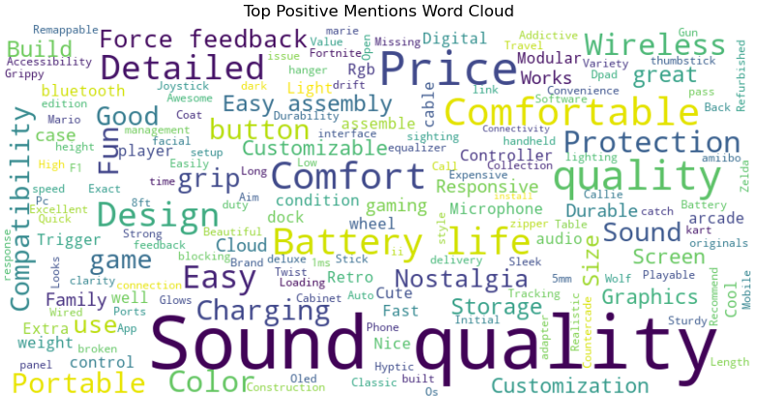
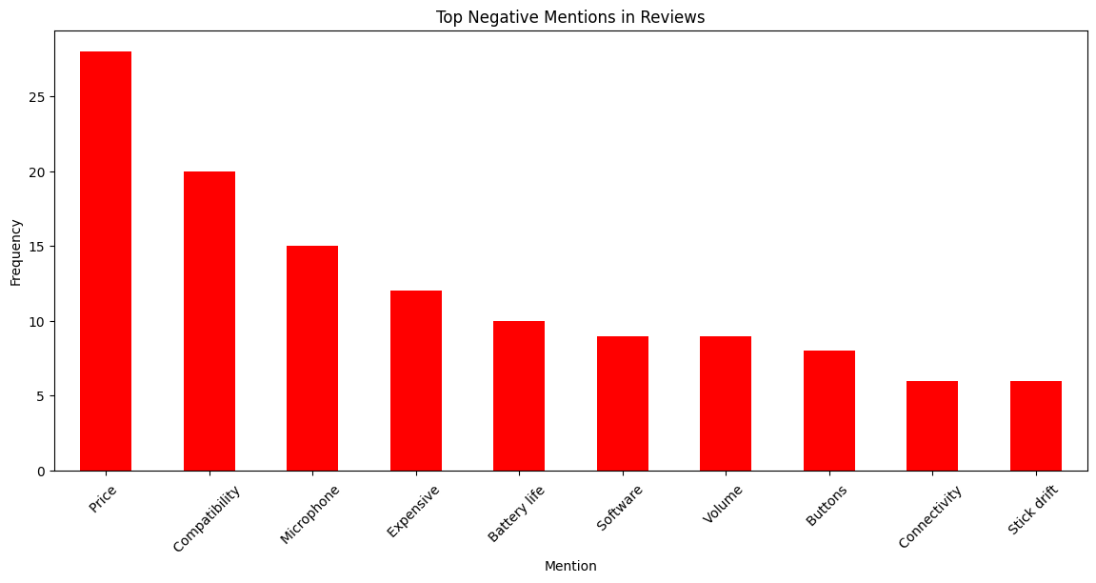
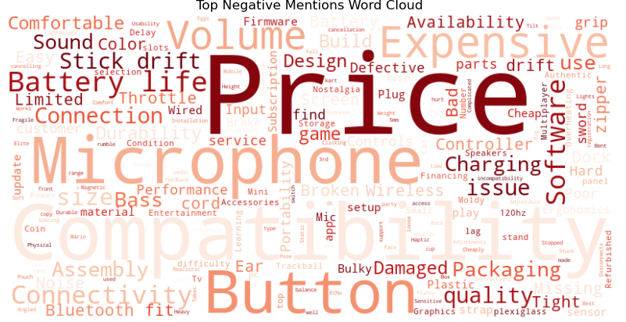
Data Visualizations -
Review Analysis :Top Mentions
Positive Mentions:
Sound quality, comfort, and price lead positive feedback.
Negative Mentions::
Price, compatibility and microphone quality dominate complaints.
Enhancing affordability and addressing reliability issues (microphone, battery, and connectivity) can significantly improve customer satisfaction.

Slide 23
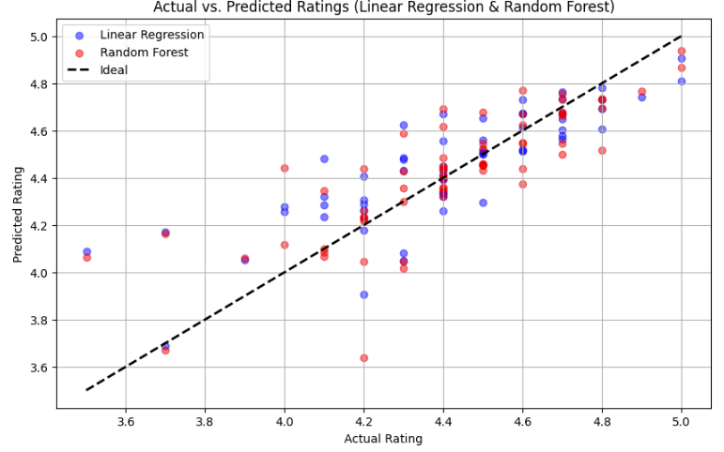
Predictive Modelling
To evaluate whether Best Buy's product offerings align with customer satisfaction, we employed a Random Forest and Linear regression model.
The resulting scatterplot illustrates the predicted customer ratings against the actual ratings, with the diagonal line representing perfect alignment.
The model demonstrates a strong predictive capability, suggesting that key product features like price are well-correlated with customer satisfaction.

Slide 24
06
Conclusion

Slide 25

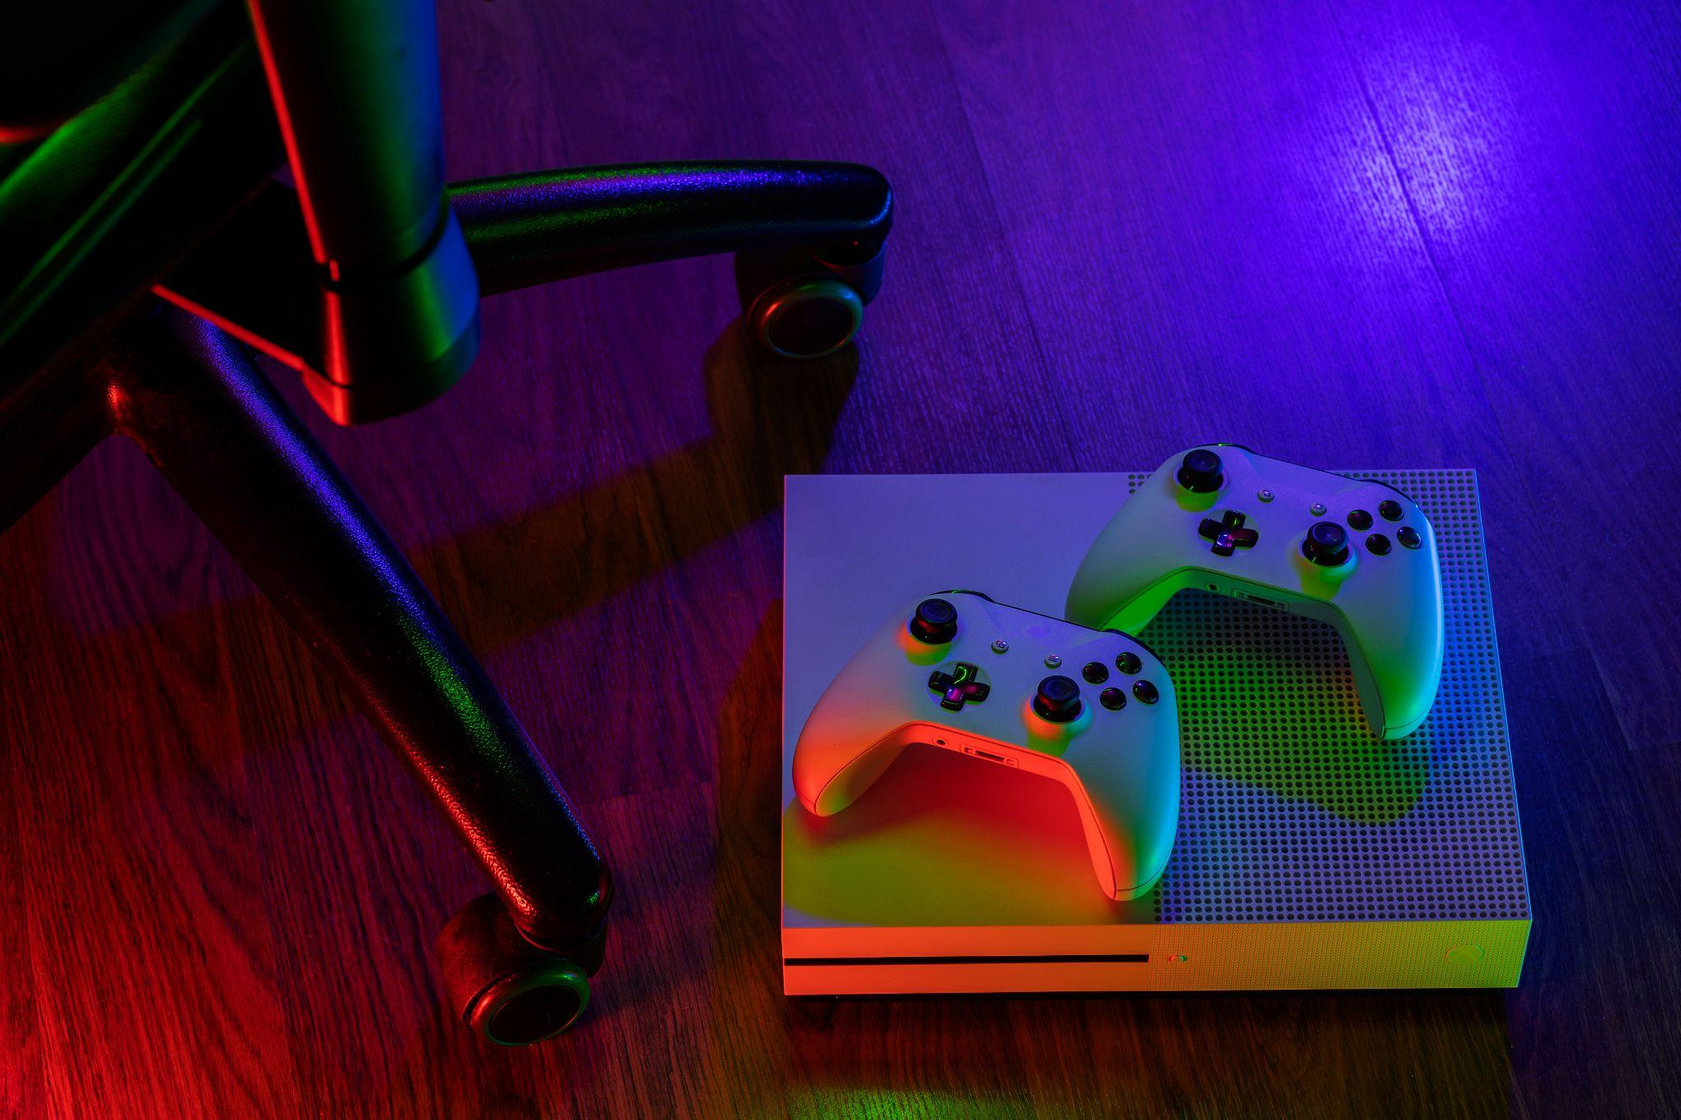
Strategic Insights
Market Overview:
The booming video game market, marked by increasing monthly accessory releases, reflects growing demand and intense competition.
Key Findings:
Top Performers: Housing brands delivering consistent quality and value reinforce Best Buy’s strategic positioning.
Improvement Areas: Brands like MSI highlight opportunities for refining product offerings.
Key Factors Driving Satisfaction: Price, functionality, and brand reputation significantly influence customer engagement.
Recommendations:
Optimize Product Mix
Enhance Customer Engagement
Sustain Competitive Edge

Slide 26
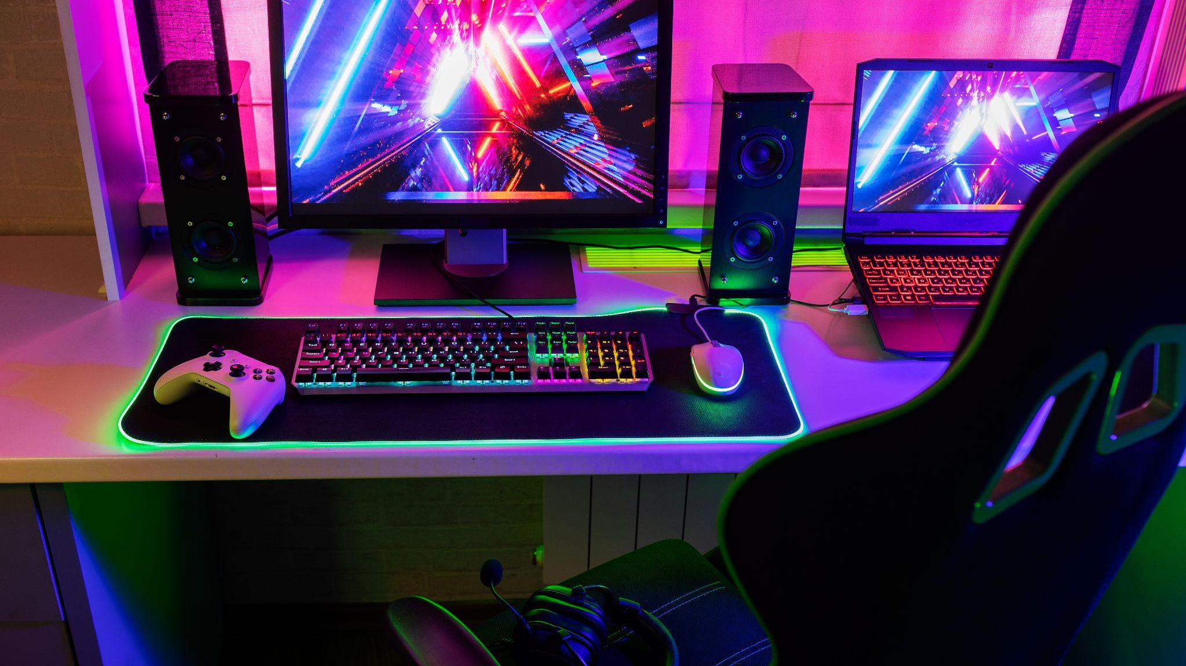
Do you have any questions?
Thanks

